Slide 1
Dr. Mingheng Li’s Senior Projects
2016 - 2017

Slide 2
Highlights
All related to industrial energy systems and water desalination.
Focus on chemical engineering fundamentals and process design principles.
Use of industry-standard software packages including Aspen Plus, Pro/II, Matlab, Comsol Multiphysics and others.

Slide 3
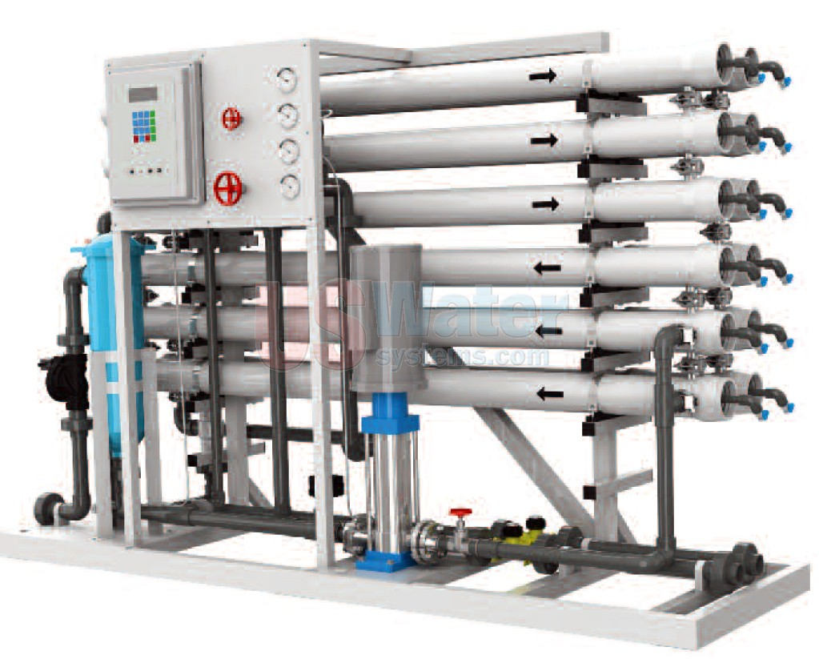
Project 1: Reverse Osmosis Membrane Desalination
We study fluid mechanics and mass transfer in commercial reverse osmosis modules used for drinking water production from groundwater and seawater.
We aim to shed insight into optimal design and operation of industrial reverse osmosis processes based on fundamental understanding obtained from this project.

Slide 4
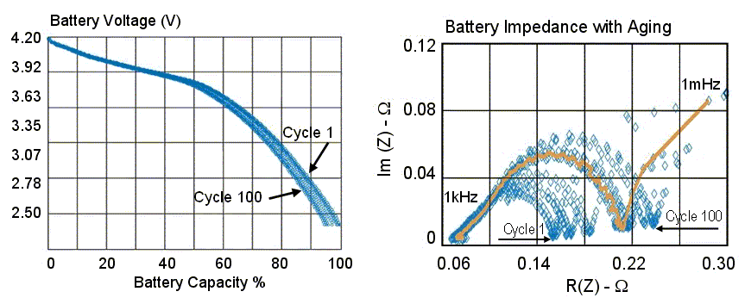
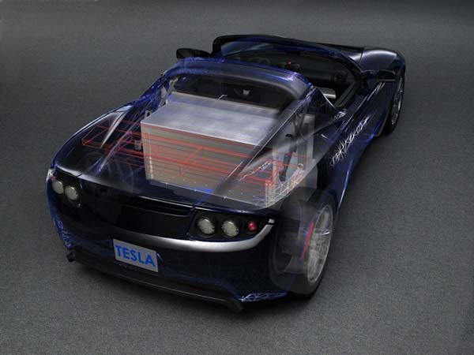
Project 2: Li-ion Battery State of Charge Estimation and Control
State of Charge (SoC) can not be measured directly when battery is in operation. However, it can be estimated by smart algorithms based on real-time current and voltage data readily available.
We implement and validate smart algorithms that can accurately estimate SoC in real-time, even if the initial guess is off.

Slide 5
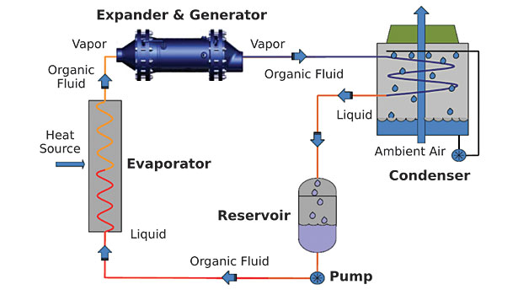
Project 3: Organic Rankine Cycle for Power Generation from Waste Heat
Organic Rankine cycle is similar to a steam cycle except that the working fluid is a refrigerant instead of steam. It works at relatively low temperatures, thus suitable for industrial waste heat recovery and geothermal applications.
We aim to address design and operation issues in this promising clean-energy technique.

Slide 6
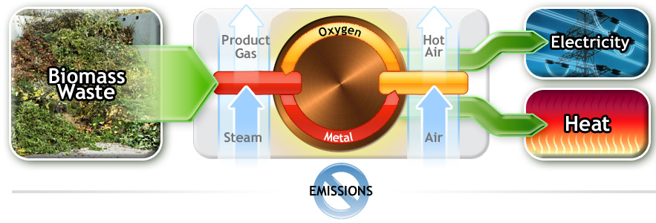
Project 4: Chemical Looping Combustion for Power Generation with Carbon Capture
It is based on Cu/CuO redox reaction to produce heat and power. It employs cyclic operation of two reactors. CO2 and N2 are naturally separated, which differs from a conventional combustion furnace. Fuel Reactor: 4CuO + CH4 = 4Cu +CO2 + 2H2O
Air Reactor: 4Cu + 2(O2 + 4N2) = 4CuO + 8N2
We aim to advance fundamental understanding of this low emission process and to shed insight into its design and operation.

